Slide 1
Computer Information Technology at Western Nevada College
Presentation to Information Technology Industry Sector Council
September 23, 2016

Slide 2
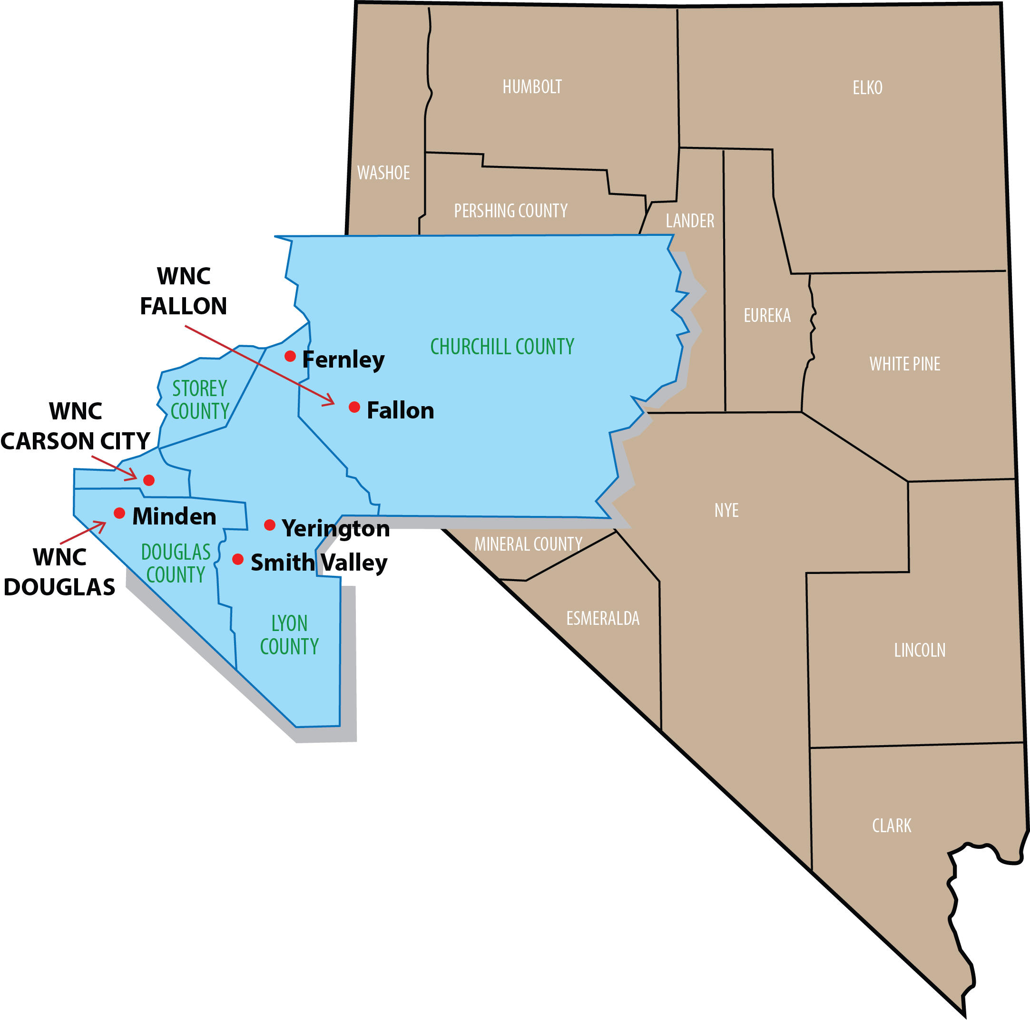
WNC Service Area

Slide 3
Mission and Core Themes
Western Nevada College inspires success in our community through opportunities that cultivate creativity, intellectual growth and technological excellence, in an environment that nurtures individual potential and respects differences.
Core Themes
Student Success
Institutional Excellence
One College Serving Many Communities

Slide 4
WNC’s Computer Information Technology Program
CIT program part of Career and Technical Education
Skills Certificates—9+ hours resulting in third party/external certification
Certificate of Achievement—30 credit hours with industry certifications
Associate of Applied Science—60 credit hours with industry certifications
Advisory Board
Comprised of industry professionals
Meets twice a year—curriculum/training alignment with industry

Slide 5
WNC’s Computer Information Technology Program
Program Areas of Study
Cisco Networking Academy
CCENT –entry level networking
CCNA—networking associate
Routing and Switching
Security
Wireless
Linux Essentials

Slide 6
WNC’s Computer Information Technology Program
Program Areas of Study (continued)
Microsoft MSCA Server and Desktop
CompTIA
Security+
A+ /PC Pro
Project+
VMWare Academy (coming soon)

Slide 7
WNC’s Computer Information Technology Program
Information Technology Integration
Internet of Things
IoT (manufacturing and welding)
Industry 4.0
cyber-physical systems, the Internet of Things and cloud computing
Siemens certifications

Slide 8
Program Challenges and Solutions
Competent and Certified Instructors
Home Grown
Changing Technology Needs
VmWare
Database Design and SQL
Business Intelligence and Analytics

Slide 9
Contact Information
Dr. Georgia White, Director, Career and Technical Education
georgia.white@wnc.ed
775.445.3348
Dave Riske, Professor, Computer Information Systems
dave.riske@wnc.edu
775-445-3255

