Slide 1
The Nevada Rural Opioid Overdose Reversal (NROOR) Project:
Successes and Lessons Learned in implementing a
HRSA-funded naloxone program

Slide 2
Project Personnel
Karla D. Wagner, Ph.D., Associate Professor, NROOR Evaluator
karlawagner@unr.edu
Christopher E. Marchand, M.P.H., NROOR and Project ECHO Project Director
cmarchand@med.unr.edu
Evan Klass, M.D., Senior Associate Dean, Office of Statewide Initiatives, NROOR Medical Director
Bobbie Sullivan, Education Coordinator, Emergency Medical Systems
Funding: HRSA 15-146

Slide 3
Partnership members
University of Nevada, Reno Schools of Medicine and Community Health Sciences
Nevada Department of Health and Human Services (State EMS Program)
Nevada Rural Hospital Partners
Desert View Hospital (lead grantee and participating hospital)
South Lyon Medical Center (participating hospital)
Grover C. Dils Medical Center (participating hospital)
Mt. Grant General Hospital

Slide 4
Context
Rural areas in the US experiencing dramatic increases in opioid overdose
2015 HRSA Rural Opioid Overdose Reversal RFA to fund:
Purchase and placement of opioid overdose devices (i.e., naloxone) in rural communities
Training of licensed healthcare professionals and emergency responders
Recently passed SB 459 authorized BLS EMS providers (e.g., EMTs) in Nevada to administer naloxone

Slide 5
NROOR Project Aims
Purchase naloxone for rural EMTs working in Basic Level Services (BLS) Agencies
Train rural EMS providers and other health professionals in overdose recognition and response
Provide take-home naloxone for rural patients receiving care for overdose in rural hospitals
Demonstrate improved and measurable health outcomes among rural patients being treated by rural EMS and healthcare professionals

Slide 6
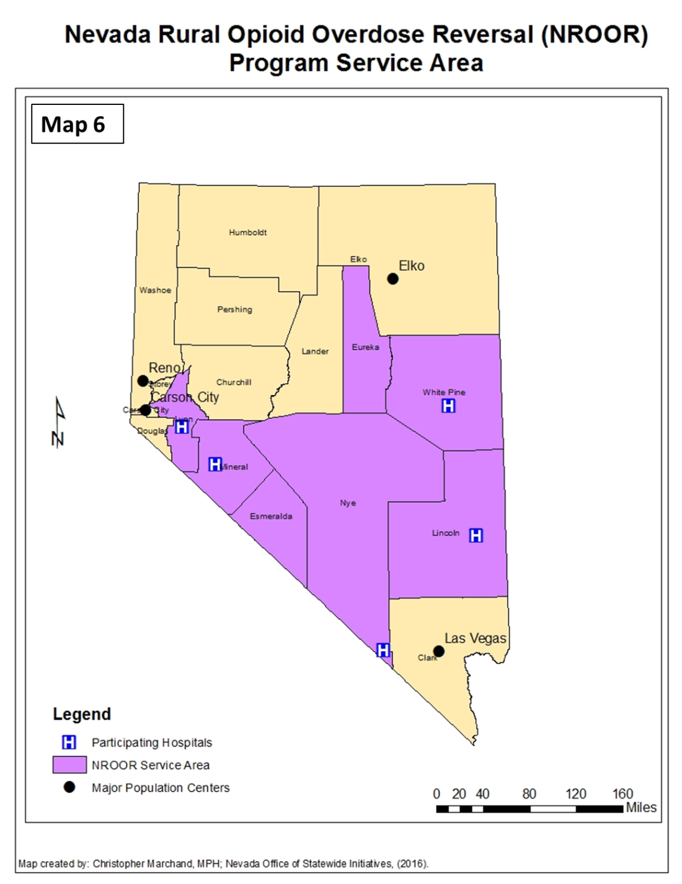
Project Service Areas:
Esmeralda County
Eureka County
Lincoln County
Lyon County
Mineral County
Nye County
White Pine County

Slide 7
Aim 1: Purchase Naloxone

Slide 8
Purchased:
500 prefilled syringes of naloxone & 2,500 IM needles
156 IN NARCAN kits for ED discharge

Slide 9
Aim 2: EMT Training Evaluation

Slide 10
Methods
State EMS delivered training in opioid overdose response and naloxone administration to 117 EMTs in participating agencies
Anonymous pre-/post-test surveys collected demographic information, knowledge and attitudes about overdose, naloxone, and SB 459
Evaluation plan included collecting data from state EMS data system on patient outcomes (e.g., time to naloxone administration, patient status, etc.)

Slide 11
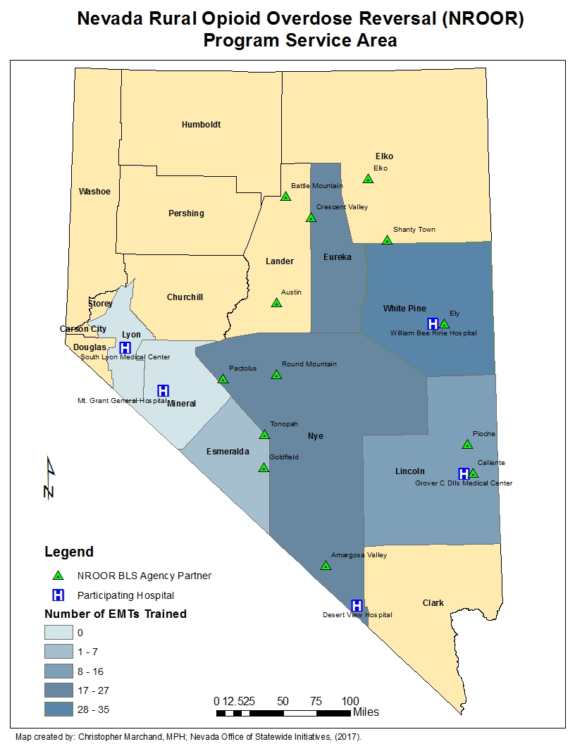
Results
117 EMTs trained from February – April 2016
Median years served as EMT = 5 (range: 0-35)
85% were volunteer EMTs

Slide 12
Results: Knowledge & Attitudes
Significant improvement in overdose knowledge scores, though overall knowledge of overdose symptoms was already high (most >80% correct)
Significant improvement in naloxone knowledge scores
To be expected, since EMTs were newly authorized to use naloxone via SB459
Significant improvement in self-assessed overdose response competence and reduction in overdose response concerns

Slide 13
Results: SB 459 Knowledge
Only 37.6% had heard of SB459 before the training in Spring 2016
* P <0.05

Slide 14
Results: SB 459 Support

Slide 15
Aim 3: provide Take home naloxone for ED discharge

Slide 16
Take home naloxone for ED discharge
Hospitals were hesitant to implement take home naloxone distribution upon ED discharge
Two hospitals did some (~12 doses distributed, maybe more)
Logistics of standing orders & distribution protocols were challenging
Lack of information and/or concerns related to liability protections and other provisions in SB 459

Slide 17
Aim 4: demonstrate improved patient outcomes

Slide 18
Results: Patient Outcomes
Based on review of available NEMSIS data and calls to participating agencies, only 5 doses of naloxone administered by NROOR EMTs since Spring 2016
Calls to agencies and interviews with EMTs ongoing
Data suggest they are not being called to opioid overdose emergencies with the expected frequency

Slide 19
Challenges and successes/lessons learned

Slide 20
Successes: Purchased Naloxone
Modeled our application on previous grants to buy AEDs for rural communities
Though the RFA appeared focused on first responders, we successfully included distribution of take home naloxone for ED discharge
Purchased >500 doses of naloxone (most to expire November 2017)

Slide 21
Successes: EMT Training
117 rural EMTs trained over 2-3 week period
Successful partnership between UNR and State EMS to deliver and evaluate training
Evaluation results
Statistically significant improvement in almost all naloxone knowledge questions
Opioid overdose competency and concerns scales showed significant improvement
Knowledge of and support for naloxone provisions in SB459 increased (though support is not overwhelming)
Favorable review by EMTs

Slide 22
Challenges: Funding logistics
HRSA RFA required partnership with a rural entity
While this was an innovative partnership, administrative and logistical issues slowed implementation
Naloxone purchased in bulk and set to expire this fall

Slide 23
Challenges: Lack of SB459 knowledge and hesitance from some prescribers
“Not on my license”
Despite liability protections in SB 459, some doctors didn’t know about or trust the law, resulting in hesitance to write standing orders and/or facilitate distribution
Now in 2017, knowledge about SB 459 among health care providers and prescribers is still low
Don’t know, don’t understand, or don’t trust
More information and interpretation could reassure providers
Notes:
Though SB459 provisions were effective Oct 2015, implementation has been slow

Slide 24
Lesson Learned: Need Better Data
HRSA proposal was written using statewide hospital billing data, based on ER admissions and opioid overdose deaths
Though we established the significance and saw a need, the experience of EMTs in the NROOR service areas does not appear to match
Only 5 doses of NROOR naloxone had been administered
Data suggest few NROOR EMTs encounter opioid overdose in their regular practice
Ongoing surveillance and will help better target resources

Slide 25
Lessons Learned: Need Centralized Coordination
NROOR was a one-time, one-year grant, partnership between UNR, EMS, and hospitals
Need a plan for sustainability
Lack of knowledge among providers still an issue that requires coordinated communication and reassurance
Unclear where parties should seek information about statewide opioid overdose response, interpretation of laws, guidance on procedures/protocols for take home naloxone and distribution
Centralized coordination would help support sustainable and integrated response

Slide 26
Naloxone Access Efforts

Slide 27
Opportunities for expanded access to naloxone
Target population | Strategies | Considerations
High risk populations (drug users, OD patients, recent detox or incarceration) | Distribution through CBOs, jails, treatment centers, health departments, EDs Pharmacy sales | Prescribers need more info & reassurance about SB459 Prescribers need models for standing orders Cost to purchase at pharmacies
Chronic pain patients | Co-prescription Pharmacy sales | Need to implement risk screening Need co-prescribing protocols
Uniformed first responders | Equip with naloxone | Alleviate liability concerns Need data on who arrives first (targeted deployment) More info about 911 Good Sam
Bystanders (friends, family members, others in position to assist) | Distribution through CBOs, treatment centers, health departments Pharmacy sales | More information about who should carry, how to obtain Cost to purchase at pharmacies

Slide 28
Statewide Naloxone Distribution Update
Redistribution of NROOR Naloxone
Establishing Community Partners for Distribution
Virtual Dispensary

Slide 29
Redistribution of NROOR Naloxone
400 prefilled syringes distributed to rural BLS agencies based on EMS data and hospital ED data
Post-project naloxone inventory indicates unreliable data used for distribution plan
With only 5 doses of naloxone administered by rural EMTs, it highlights the need for improved data collection and reporting systems
Remaining NROOR naloxone will be redistribute to Trac-B Exchange in Las Vegas and Northern Nevada HOPES in Reno to be used before it expires

Slide 30
Establishing Community Partners for Naloxone Distribution
Trac-B Exchange
Northern Nevada HOPES
Clark County Correctional Facility
Law Enforcement and Court System
Community Paramedicine

Slide 31
Virtual Dispensary
Innovative resource that will prevent maldistribution of naloxone
Participating organizations will have the appropriate formulary stock of naloxone at all times
Naloxone is much less likely to expire without being used
Efficient use of resources – No need for Nevada to store or ship naloxone, and funds are spent wisely leaving more funding available for other initiatives

Slide 32
Provider Education
NROOR focus shifting to academic detailing and other provider education activities (SB 459 & AB 474)
Project ECHO Nevada:
Expand existing Pain Management ECHO clinic from once per month to twice per month
Launched Medication Assisted Treatment (MAT) ECHO clinic September 27th, it will take place twice per month
ECHO Nevada infrastructure remains available as a rapid information dissemination resource – legislation and regulation updates, public health emergencies, sharing of best practices

Slide 33
Conclusion: Major contributions of NROOR
Increased awareness & educational moments
Trained 117 EMTs
Purchased naloxone
Statewide and national visibility
Created a model that can be modified based on lessons learned
Bulk naloxone purchase set to expire →“virtual” naloxone dispensary center
SAMHSA STR building upon and expanding NROOR efforts as appropriate
Naloxone access
Provider education

